Slide 1


Slide 2
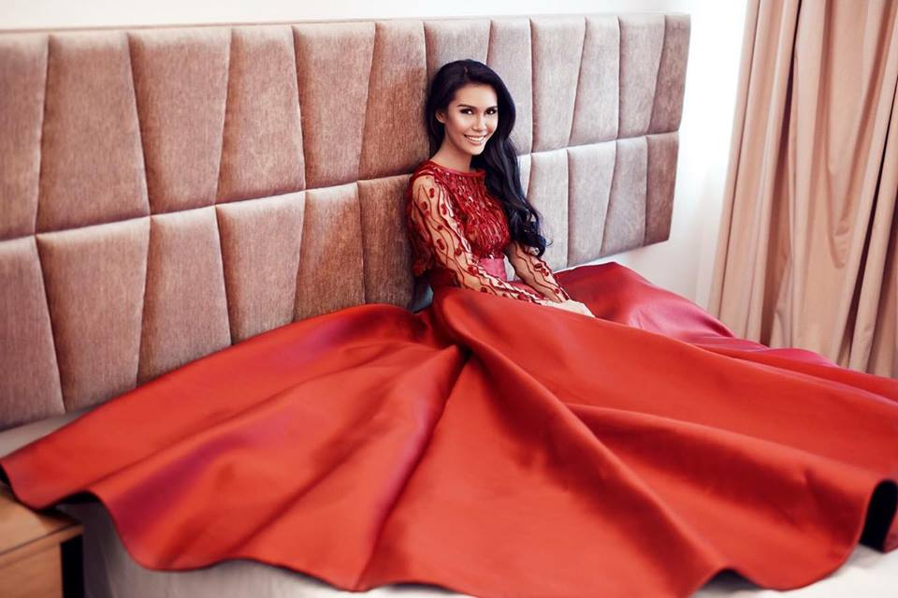
Miss Earth 2015 Angelia Ong

Slide 3
Titles:
Miss Earth 2015
Miss Philippines Earth 2015
Miss Manila 2nd Runner-up 2014
Face of Bb. Pilipinas 2011

Slide 4
Hosting Jobs:
State of the City Address of Manila City 2014-2015
Miss Manila 2015 – 2016
Miss Global Philippines 2013
Asia Pacific Forestry Week
World Wildlife Day
International ICT Awards 2016
Viber Launch
San Miguel Thanksgiving Party
Calvinayre.com
Metro Manila Film Festival Events
Bayer Animal Health Recognition Night Event

Slide 5
Endorsements:
Gloww Food Supplement
Personal Collection – Amazing Intimate Wear
Cream Factory
True Religion Jeans
Guess – Brand Ambassador
Vans – Brand Ambassador
Magazine / Website Covers:
Hardware Zone Magazine (HWM) September 2015
Sister Secrets
Village Pipol – June 2016
Scenezone Magazine – July 2016

Slide 6




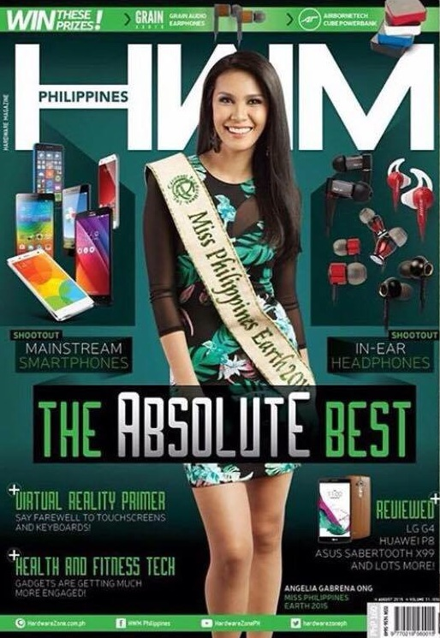

Slide 7


Slide 8


Slide 9
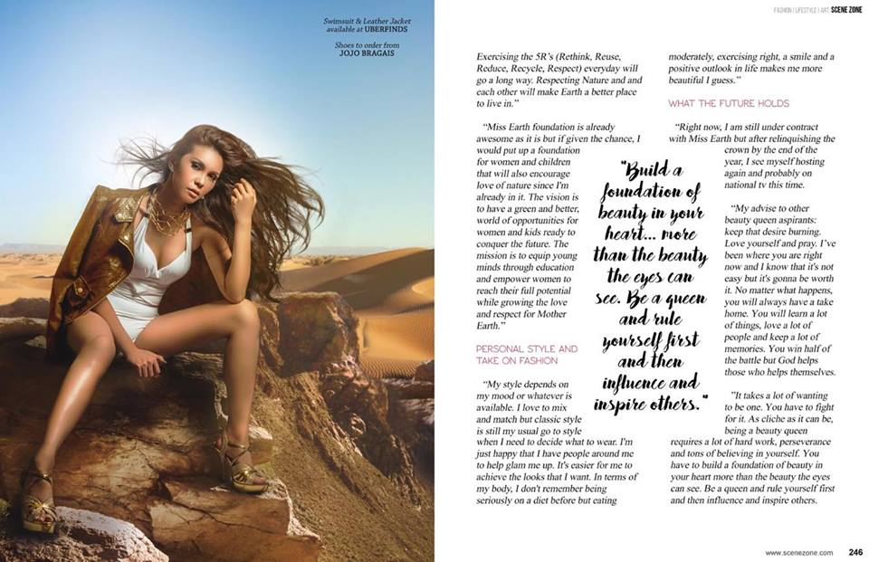

Slide 10


Slide 11
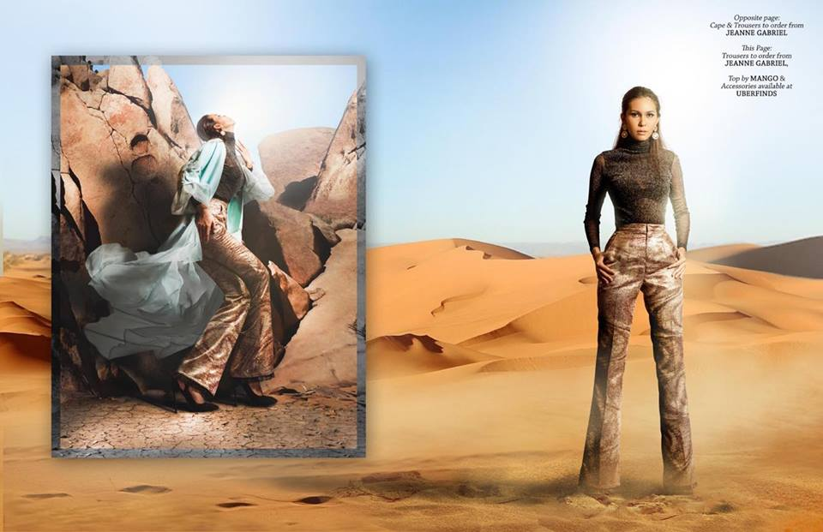

Slide 12
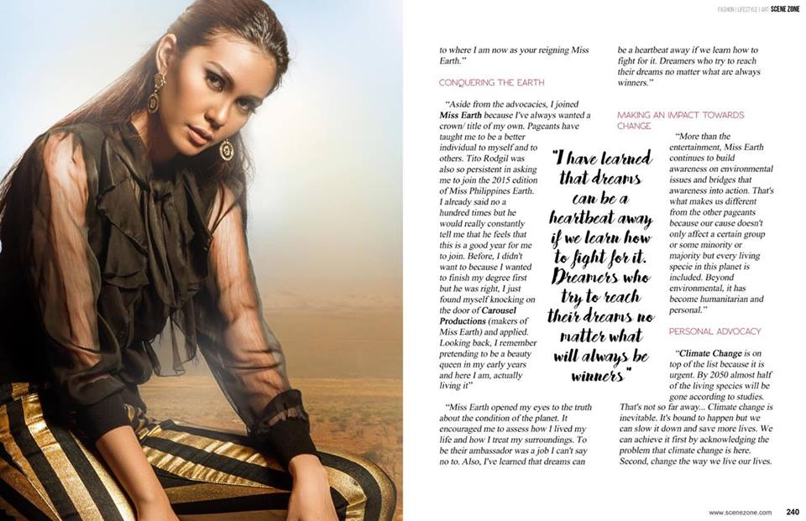

Slide 13


Slide 14
Interviews:
Aquino and Abunda – 2015
Tonight with Boy Abunda – 2016
Umagang Kay Ganda
DZMM Teleradyo
CNN Philippines
ANC
Gandang Ricky Reyes – GMA News TV
ETC – Etcetera
Chinoy TV – Feature for Women’s Month
Rated K – Valentine’s Day Special
RX 93.1

Slide 15
Countries Visited for Miss Earth:
Vienna, Austria – Miss Earth 2015 Coronation Night
Reunion Island – Miss Earth Reunion Island 2016 Coronation
Vietnam – Guest of Honor for Adora Spa and Clinic Opening
USA – Miss Earth US Coronation
India – Miss Earth India Coronation
Mauritius – Miss Earth Mauritius Coronation
Sri Lanka – Miss Earth Sri Lanka Coronation
Singapore – Guest of Honor for F1 Racing with Huan Ya Yu Le

Slide 16
Seminars Attended:
The Climate Reality Project – Leadership Training with Former US Vice President Al Gore (An Inconvenient Truth)
Asian Forestry Week 2016
Sustainable Enterprise Summit 2016

Slide 17
Links for Hosting, Interview Videos:
Calvinayre.com: Agelia Ong Talks to G@E Asia Attendess on Day 1: https://www.youtube.com/watch?v=tsdk25KUIOE
MYX VJ Search 2014 Audition Video: https://www.youtube.com/watch?v=lBcrsoINl4c
Ms. Philippines – Earth 2015 Q&A
http://www.youtube.com/watch?v=W3hQOS99nCQ
Angelia Ong on Aquino & Abunda: https://www.youtube.com/watch?v=b8SzDkazICk
MS. GLOBAL PHILIPPINES 2014:
https://www.facebook.com/video.php?v=10153411308079012&set=vb.516844011&type=2&theater
https://www.facebook.com/video.php?v=10153411307769012&set=vb.516844011&type=2&theater

